Slide 1
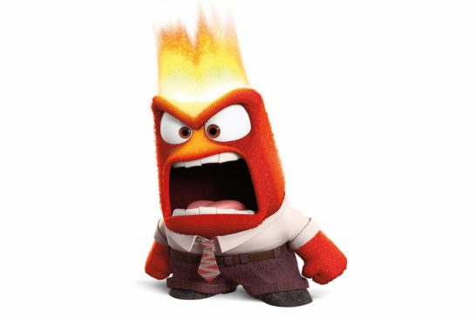
LO: To learn what anger feels like and understand how it affects what we do.

Slide 2
Circle time!
What makes you feel angry?
How do you behave when you feel angry?
How does it make you feel inside?
What happens to your body on the outside?

Slide 3
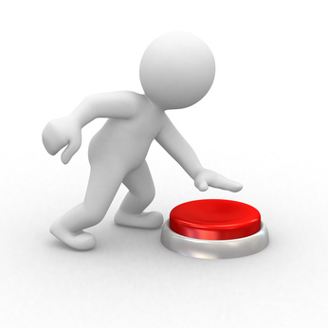
Activities…
What pushes your buttons?

Slide 4
What makes my balloon pop?

Slide 5
How to let anger go…

Slide 6
Anger game!

Slide 7
What have you learnt?
What will you try to work on?
Belly breathing time!

